Slide 1
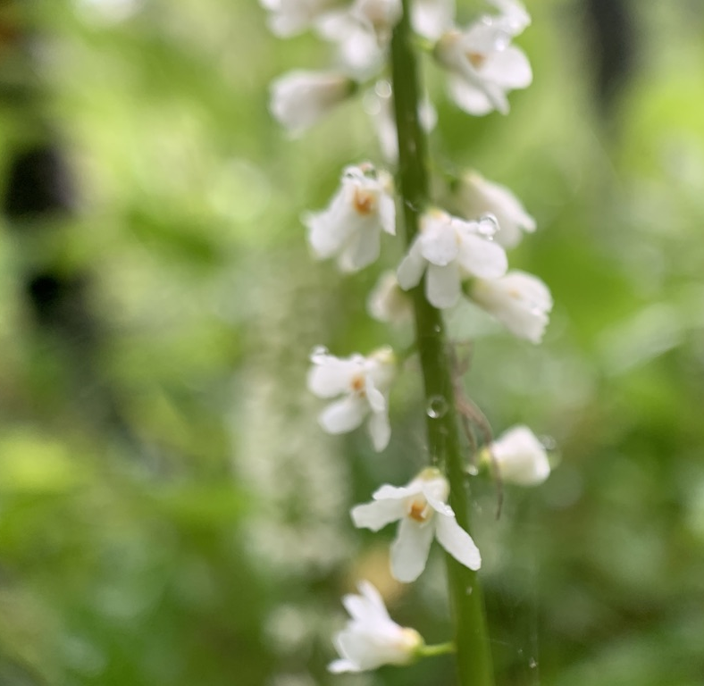


Using R for Digitized Natural History Collections in Research
@ShellyGaynor
Michelle Gaynor

Slide 2
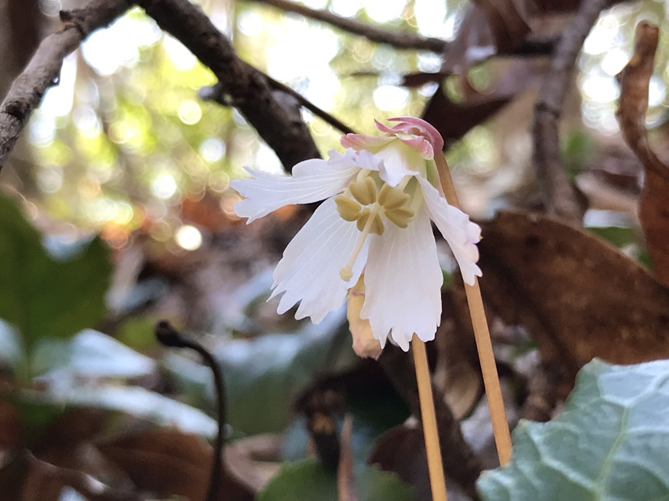
Outline
Setup
Cleaning Data
Resolve taxon names
Decrease number of columns
Clean localities
Remove duplicates
Save
Mapping
ggplot2 and leaflet
Point Statistics
ANOVA

Slide 3
Outline
gatoRs
Setup
Cleaning Data
Resolve taxon names
Decrease number of columns
Clean localities
Remove duplicates
Save
Mapping
ggplot2 and leaflet
Point Statistics
ANOVA
Geographic And Taxonomic Occurrence R-based Scrubbing

Slide 4
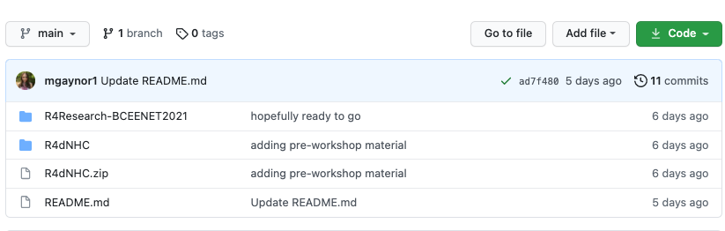
https://github.com/mgaynor1/R4NaturalHistoryCollections-BCEENET2021

Slide 5
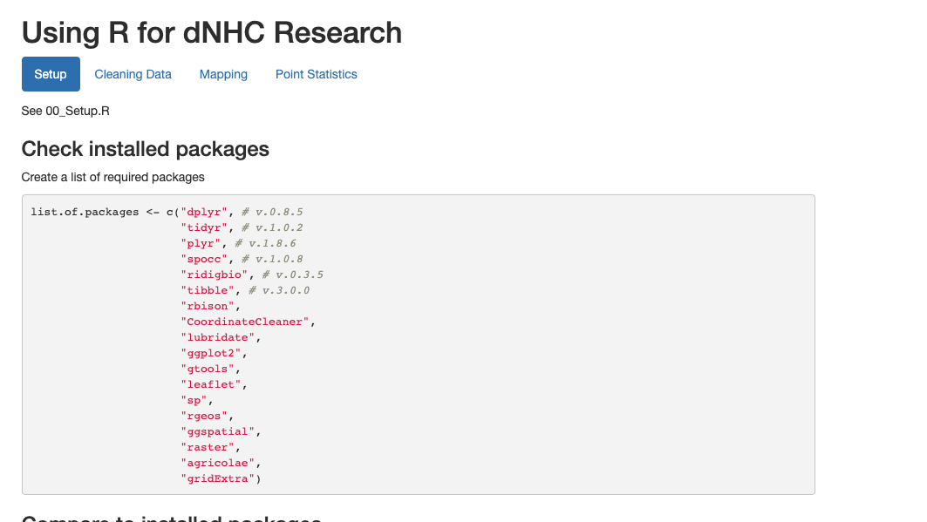
https://github.com/mgaynor1/R4NaturalHistoryCollections-BCEENET2021

Slide 6
Gaynor, M. (2020). Introduction to R with Biodiversity Data. Biodiversity Literacy in Undergraduate Education, QUBES Educational Resources. doi:10.25334/84FC-TE88

Slide 7
Gaynor, M. (2020). Cleaning Biodiversity Data: A Botanical Example Using Excel or RStudio. Biodiversity Literacy in Undergraduate Education, QUBES Educational Resources. doi:10.25334/DRGD-F069

Slide 8
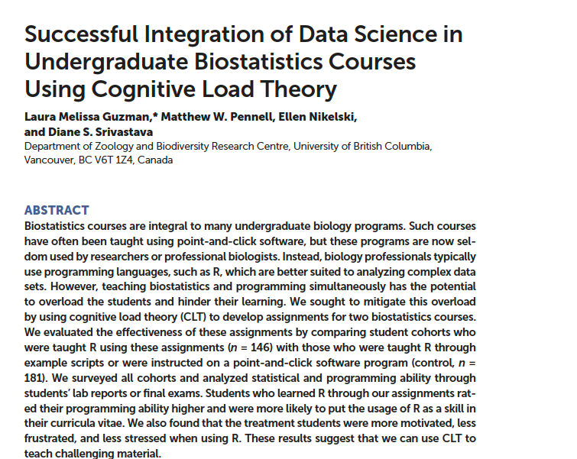
CBE—Life Sciences Education • 18:ar49, 1–10, Winter 2019

Slide 9
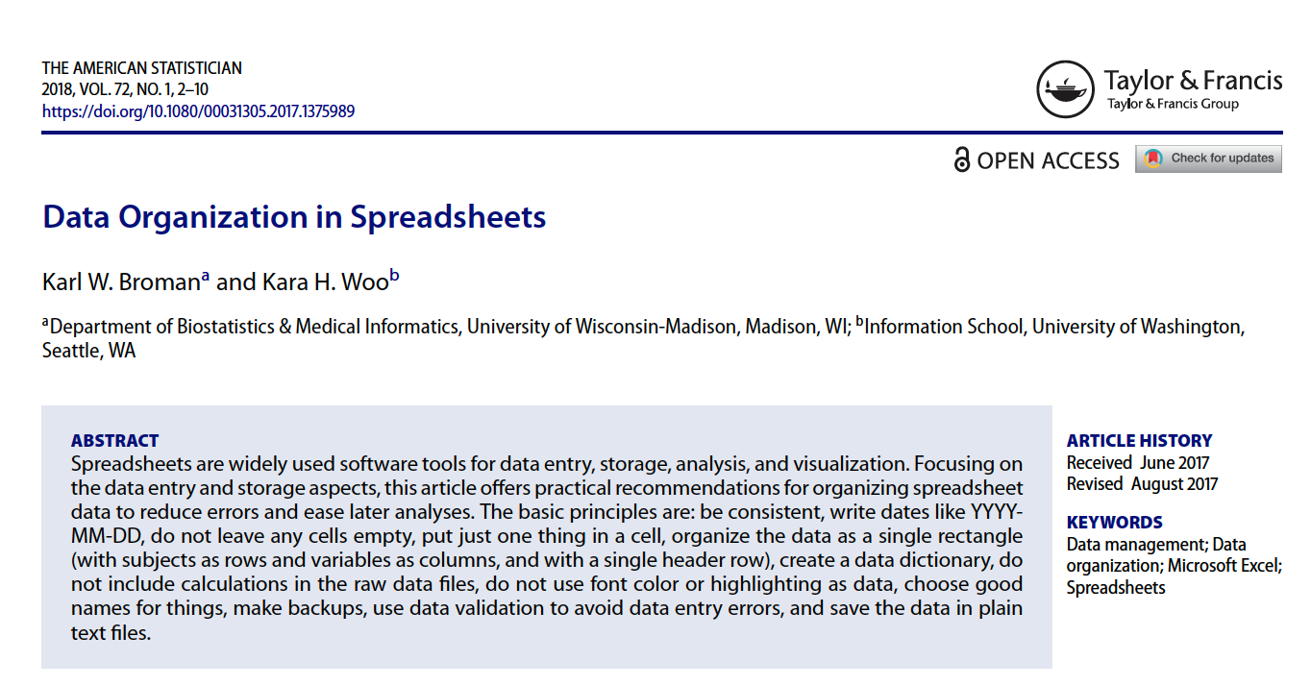
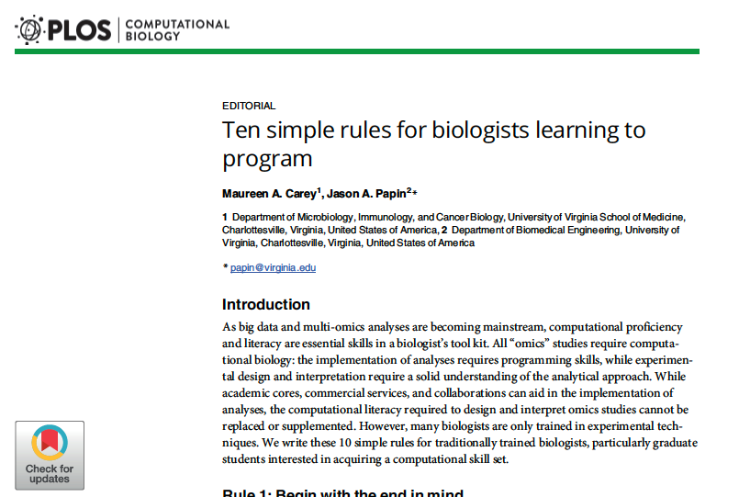

Slide 10
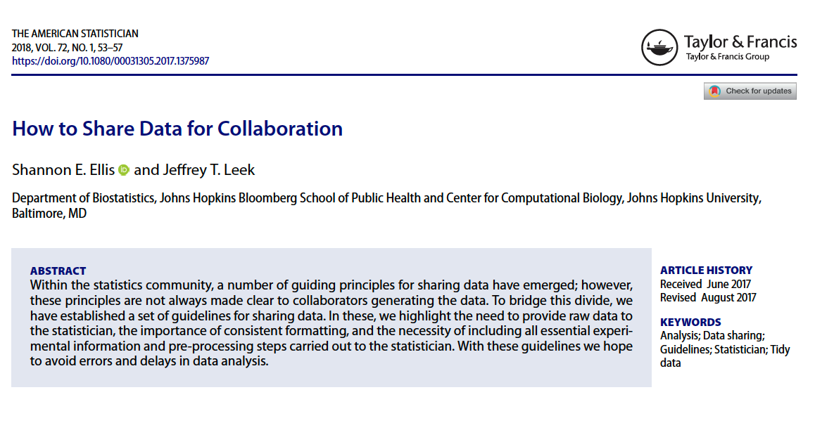

Slide 11
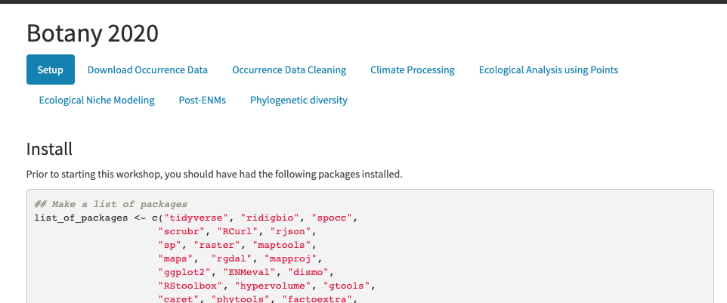
https://github.com/soltislab/BotanyENMWorkshop2020

Slide 12
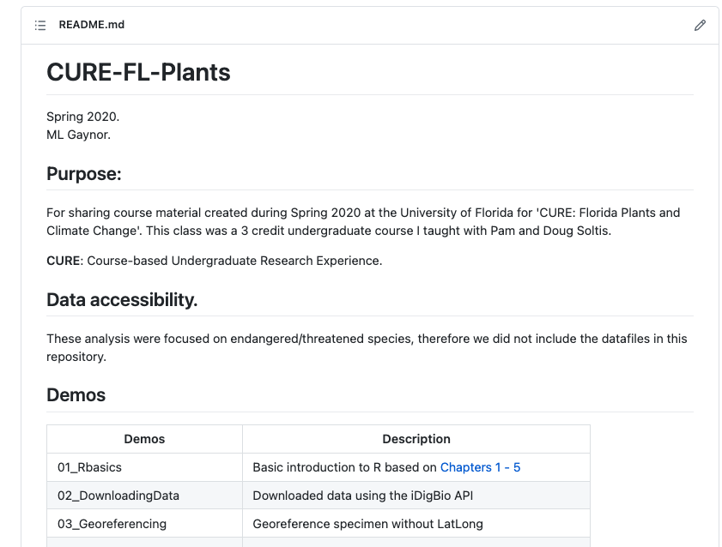
https://github.com/mgaynor1/CURE-FL-Plants

Slide 13
https://github.com/mgaynor1/R4NaturalHistoryCollections-BCEENET2021

